Slide 1
TabX
Typing assistant for browsers

Slide 2
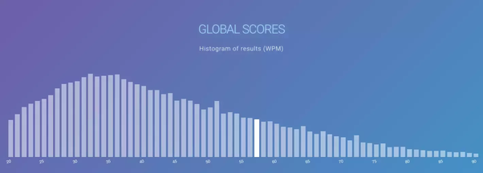
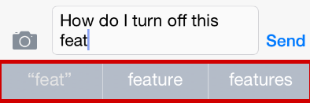
The World Needs a Writing Assistant
Notes:
Pre: Transition, We Want to fill a problem
First Click
Average typing speed in the US 40 WPM
Limits ability to use computer
Creates a gulf among users
Browsers are the hub of modern computer use
Next Click:
Phone Companies have already Identified this problem
Helped make the phone the most popular computer
Make it easier to use computers

Slide 3
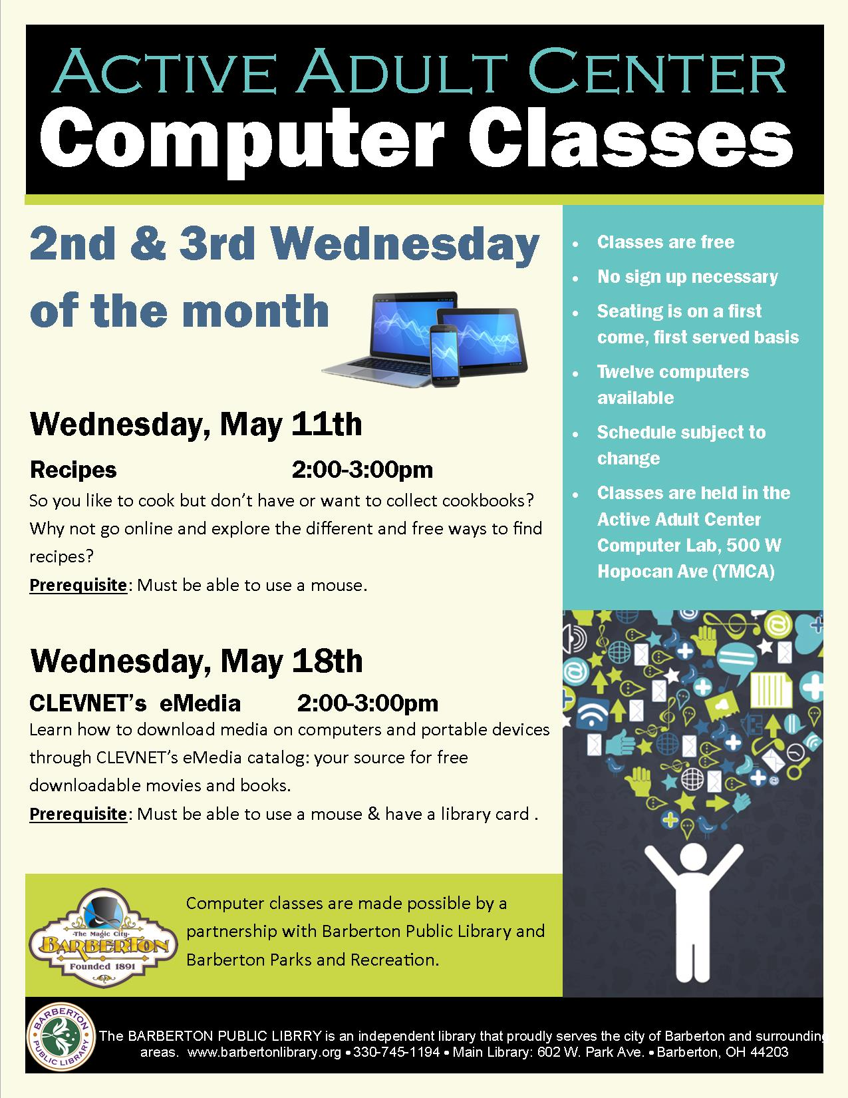
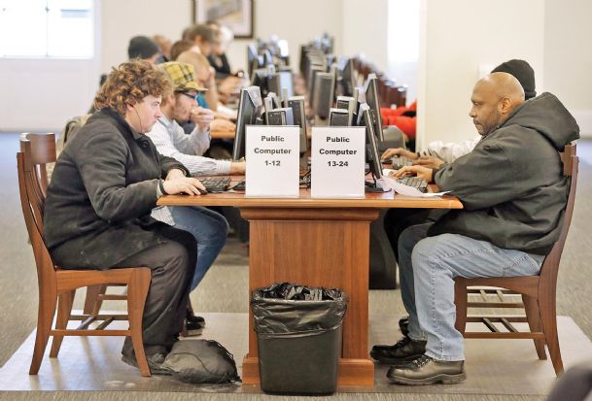
Client: The Public Library
Notes:
Pre click:
Transition
First Click:
Has a large proportion of inexperienced computer users Use computers in a time sensitive manner
Next Click:
Wants Speed up ability to type on browsers An intuitive format reminiscent of phones Cleanly incorporate into browsers Filter profanity

Slide 4
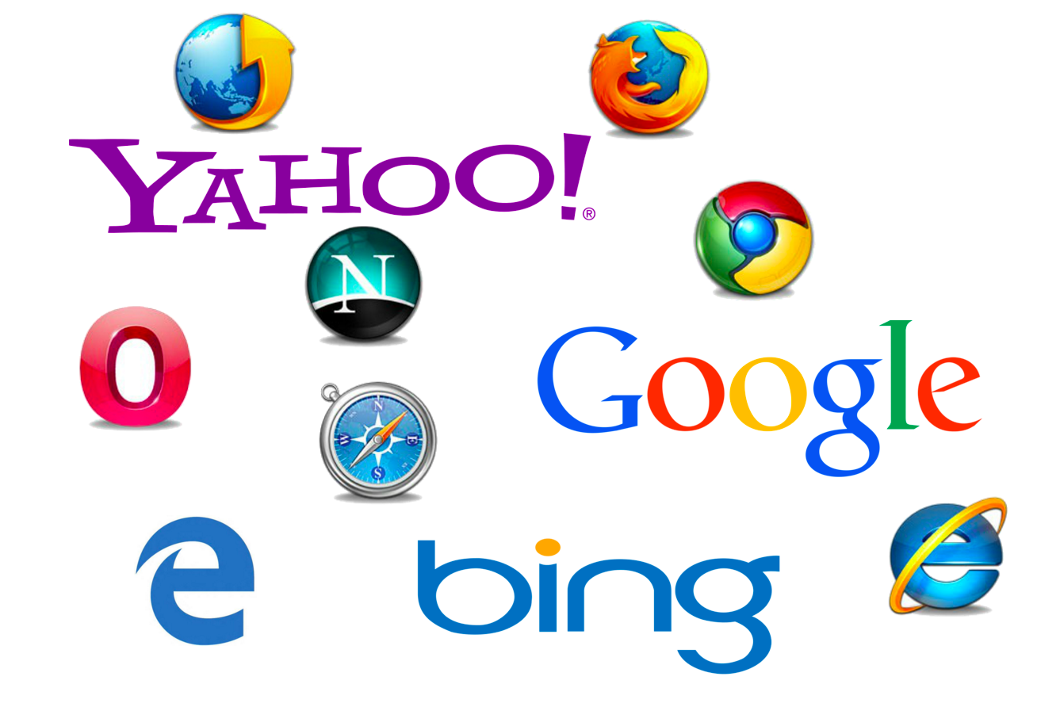
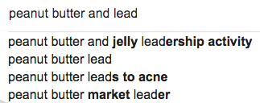
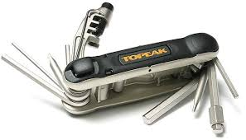
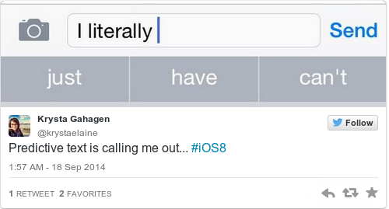
What we will achieve
A multifaceted typing assistant
Notes:
First Click: Predict the Next Phrase
Next Click: Predict the next word
Next: Import into browsers
Next: Add Tools as needed
Next: To Crate a

Slide 5
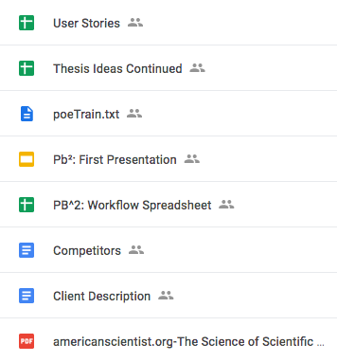
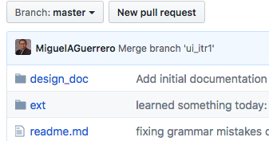
Recording and Repository
Notes:
First Click: Google Drive Spreadsheet to track decision Presentation and report files Easy to perform small edits
Github Code and other related files Version control

Slide 6
Back-End Overview
2 Parts:
Word completion - as user typing a word, predict what the word is likely to be
Next word prediction - as user finishes typing a word, predict what the next word is likely to be

Slide 7
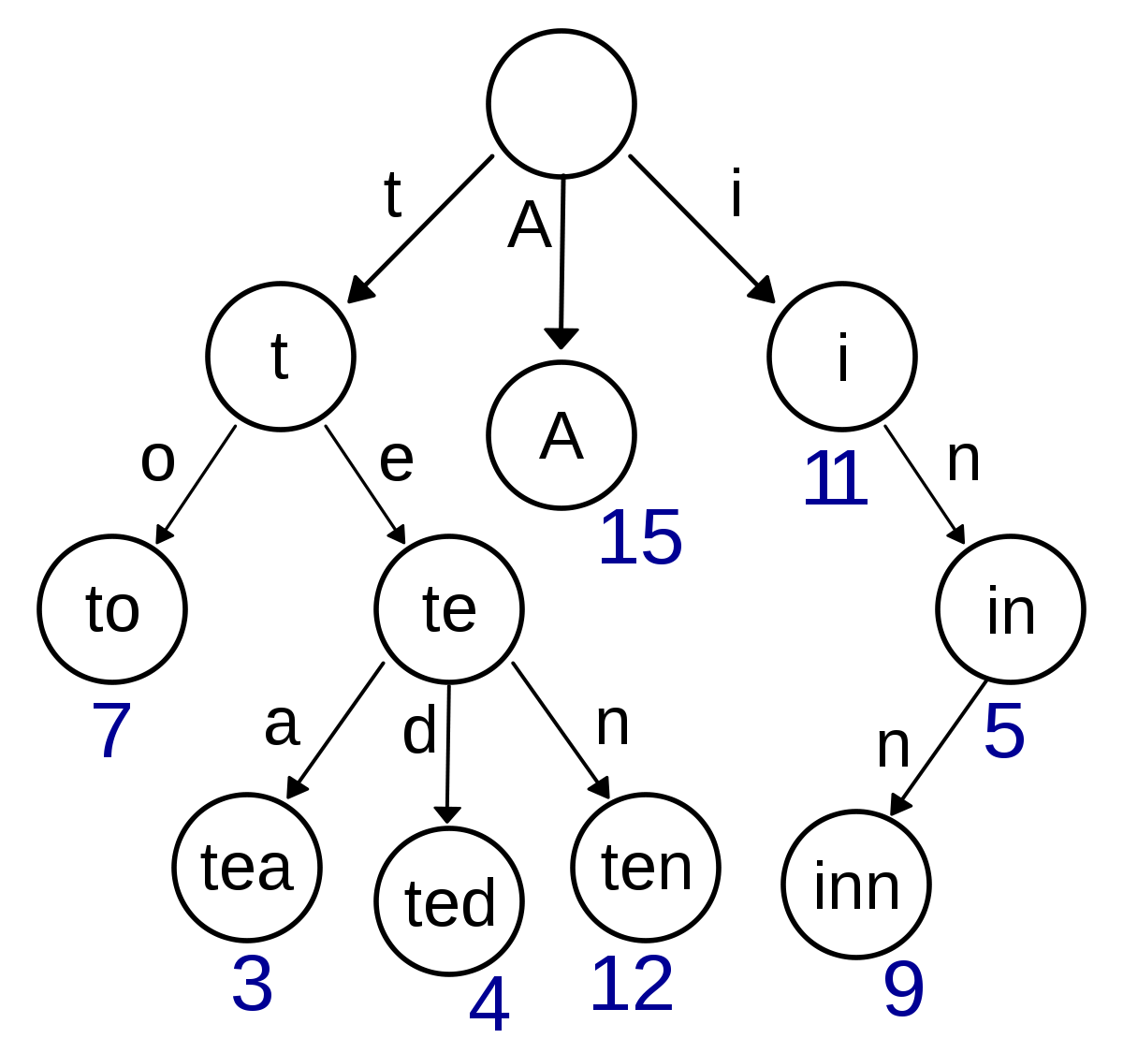
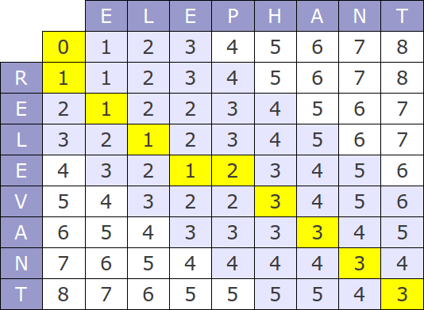
Current Word Completion: Levenshtein/Trie algorithm
Notes:
Explain Trie.

Slide 8

Technical Details (Backend)
Next Word Prediction: Recurrent neural network
Notes:
Explain RNN what it does?
We use a RNN that takes a sentence, and remembers the context of the sentence to predict the next likely word
We have the means of predicting words with our algorithms, so how do we present this information to the user?

Slide 9
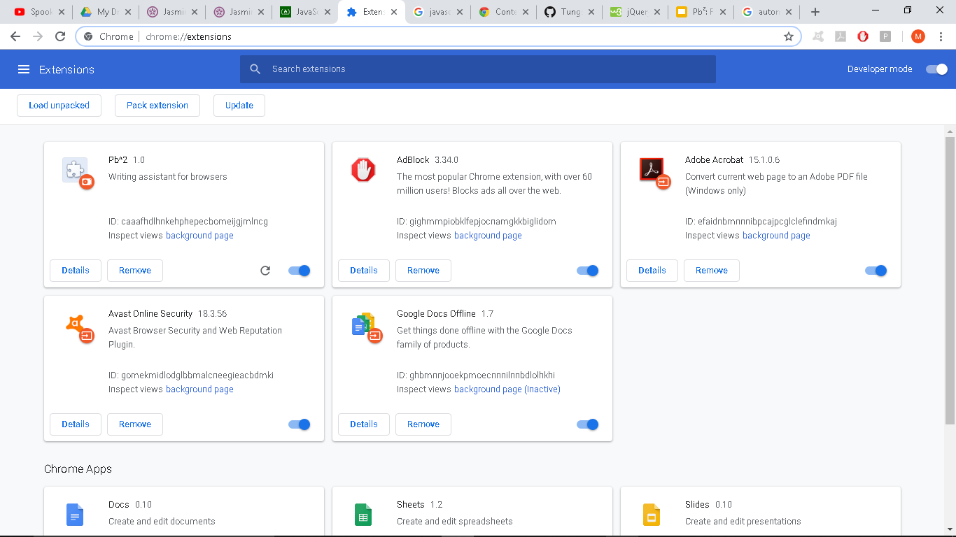
Notes:
We need to make a plugin.
In order to use this logic, we have to use a plugin, which is extra functionality added to a browser.
What does this mean?

Slide 10



Frontend
Notes:
In order to provide a writing assistance for browser we had to adhere to the chrome extension arch. which emphasizes the use of html, js
Which is nice bc the algorithms we’re using can be easily repr as code on the client side
What is the benefits of using Chrome env? Give us mean to provide visual output for the algo.s .and providing UI experience in the process.
Now that we can provide the logic to the client we want to test that the functional works? So we use Jasmine
The testing framework in use is Jasmine

Slide 11

Frontend: Testing
Notes:
Jasmine testing frame work
Is Behavior Drivien Development oriented
Helps test JavaScript
Jasmine was easier to integrate than other frameworks (Mocha, Jest, etc.)
-----------------------------------------------------------------------------------------------------
Start Here:
We use Jasmine bc it’s easy to use, easy to integration in our model
And it had friendly feel for our clients,
who can easily read and understand the behavior of the tested function
Can be convinced that it works

Slide 12
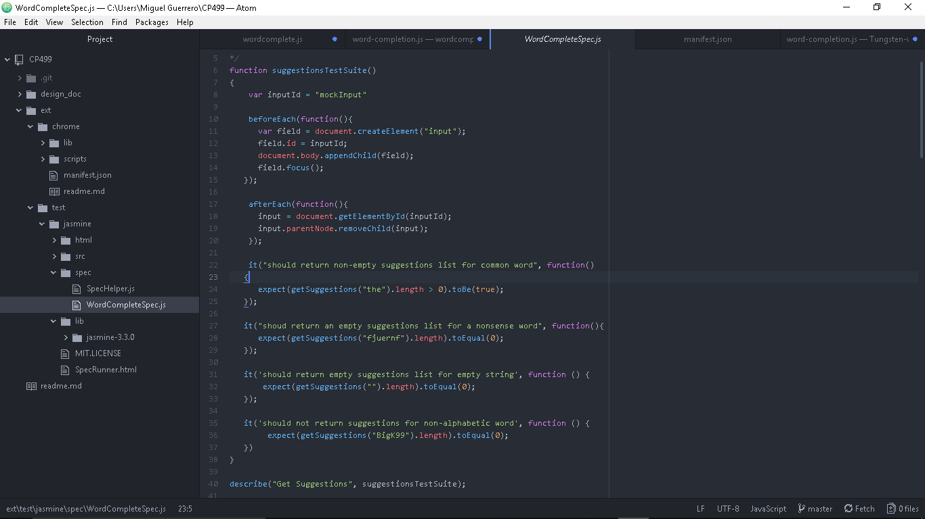
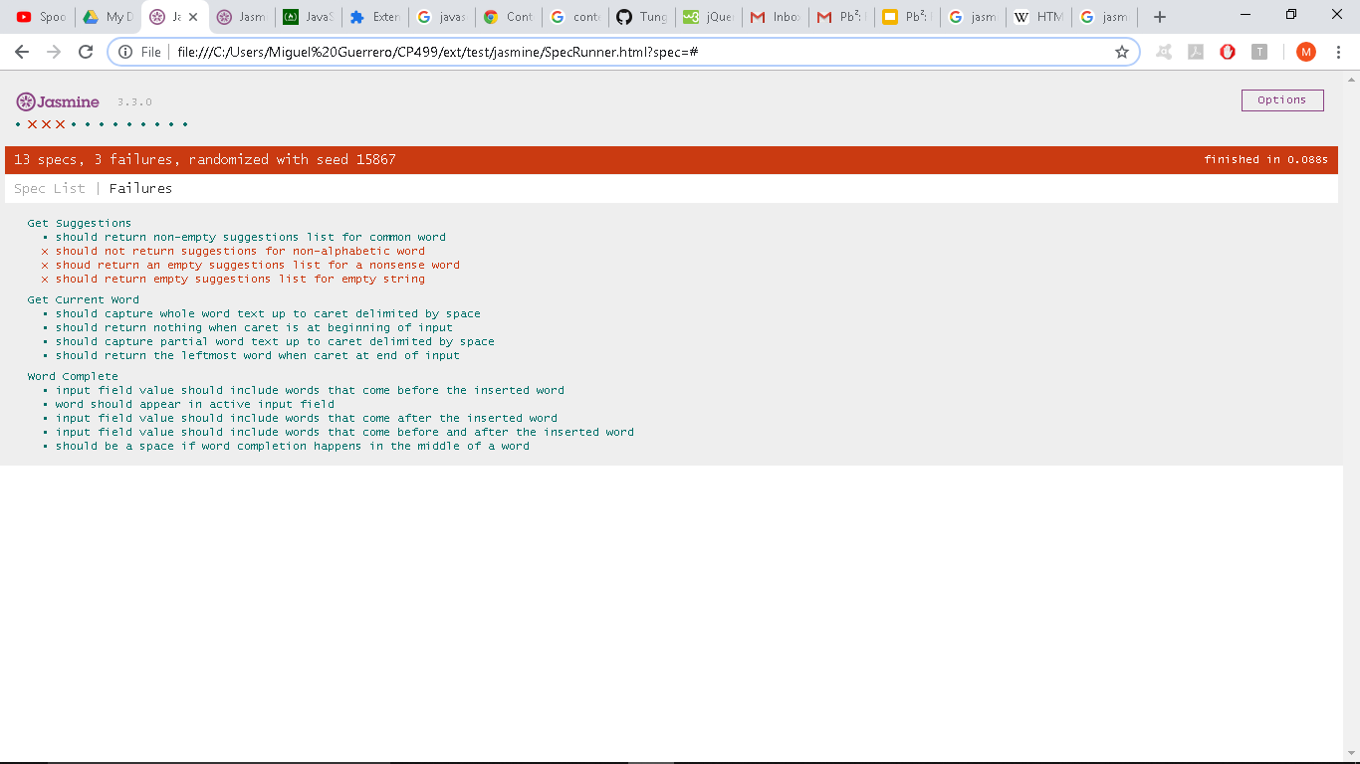
Frontend: Testing
Notes:
Features of the extension can be represented as tests
Each test represents a behavior of the app that can be easily understand by the client
Keeps us more focused on client’s need
Selenium for automated browsing?
Verify that models works
Important when we change models, which is expected
Highlight the fact that the test failed upon changing models and that this is why tests are useful

Slide 13
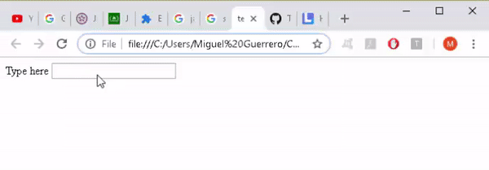
Demo
Suggestions are shown as users type
Notes:
Miguel Guerrero Tutorial
Suggestions are shown. It shows the closest 3 correct words.

Slide 14
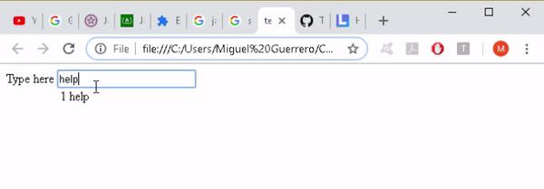
Demo
By pressing the displayed shortcut,
users can complete their words with the offered suggestions
Notes:
Pressing the number 1 can finish the word

Slide 15
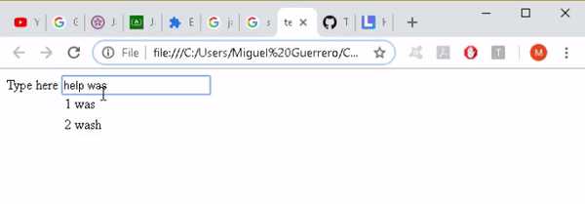
Demo
Suggestions are based on text up to the input cursor, delimited by whitespace
Notes:
Correct words in the middle. This expedited spelling changes

Slide 16
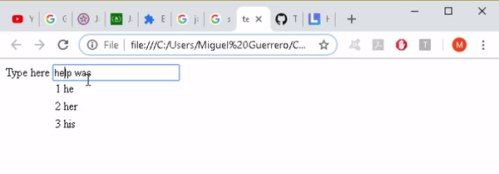
Demo
Word completion performed in the middle of text separates the trailing text with a whitespace.
Notes:
Currently

Slide 17


Challenges
Frontend
Backend
Notes:
Modules: The local modules are not the same as the Chrome modules: It's programming without being able to use imports
For Example: In current Incarnation
Oh tenser Flow. You are so strong. But much like the body builder in a horror film. Your just too big to make the cut. We spent many cold nights with you

Slide 18
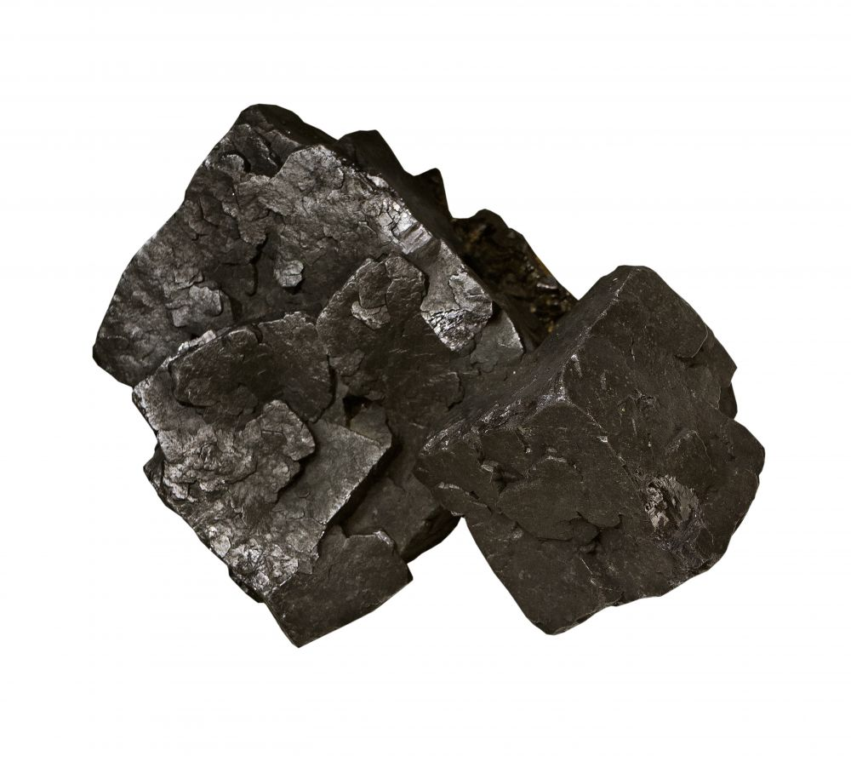
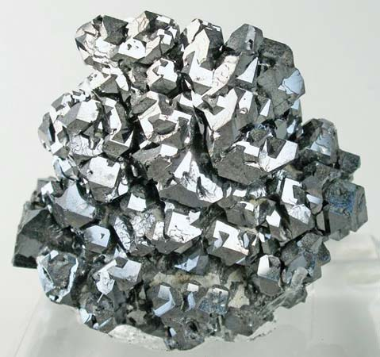
Plan & Goals
Week 1: fully integrated front and back end with both models
Week 2: client required features: profanity filter, erase search history (non-personalized), customizable word set
Week 3: polished final product, more models with greater capabilities
Notes:
A full set of goals can be Found on the google drive
Week 1 - fully integrated front and back end: We have two puzzle pieces that don't quite fit together. We need to sand them down until they fit.
Week 2 - client required features (profanity filter, erase search history (non-personalized), customizable word set)
Week 3 - polished final product, more models with greater capabilities. The goal of this project is to be easy. And you have spend a lot of hard work to make something feel easy.
I

Slide 19
Notes:
spent a significant portion of my fall break in a public library in Albaquerque New Mexico People watching. And for people coming to use the computers, Especially the elderly and the homeless. The keyboard wasn't a tool. It was an obsticle.
None of us expect that Pb2 is going to completely solve that problem. But It's going to make the whole computer expirience just a little bit easier. And isn't that the goal of software engineers everywhere.
To make the cold, hard, world a little bit easier.

Slide 20
TabX: 2.1
Writing assistant plug-in for browsers
Notes:
Quick Project Topic Reminder
What we are: Writing assistance in the browser
Finalized product name: Pb2 -> TabX
Reason: Name was more inline with actual project

Slide 21
Our client
Notes:
Pre click:
Transition
First Click:
Has a large proportion of inexperienced computer users Use computers in a time sensitive manner
Next Click:
Wants Speed up ability to type on browsers An intuitive format reminiscent of phones Cleanly incorporate into browsers Filter profanity

Slide 22


Status Update
Front-end
Can now use node.js in the development and testing environment
Back-end
Implemented/improved functional word prediction & completion models
Challenges
Integration of models
Conforming to Chrome
Notes:
Quick Status Update: Take a couple minutes to briefly describe accomplishments, changes and new challenges since the last presentation.
General
Allowed Node.js libraries to be used in development and testing
Using webpack for deployment
Makes managing dependencies easier
Encourages modular code
Front-end
Made it more flexible: decoupled UI / app logic from browser specific stuff
Created an interface with the backend
Allows models to be swapped around with worrying about
Implementation details
Back-end
Improved word completion model (trie)
Two functional word prediction models
New Challenges
Conforming to the Chrome browser environment
Integration and webifying the models
Having an already trained model (not trained in deployment)
Dependencies can work in browser
No fs

Slide 23
Front-end Plan
 | Presentation 2.2 | Presentation 3.1 | Presentation 3.2
Khayyon | Create the another display method for suggestions as a bar instead of a table Improve accessibility by developing means to set font size and color of suggestions and how they presented | Refactor/remove accessibility features and UI display methods based on UI feedback Apply filters to what text fields we do not want the extension to provide suggestion/predictions (password fields) Create UI logic as needed for other writing assistant services | Bug Hunting Update and finalize README.md file in the repo
Miguel | Polish up tabular suggestions display for word completion for consistent display across different websites Create UI logic for word prediction and make it seamless with UI logic for word completion | Refactor by removing duplicate code, consistent styling, and creating more modular scripts, each with a single responsibility. Create settings for TabX to allow users to pick what writing assistant services they want | Finalize instructional material on how to use TabX General code cleaning and documentation
Notes:
Detailed Plan
For each of the remaining milestones you should tell us what specific 1-3 goals each teammate expects to focus on. This should be presented in table or list form.
Planning in this detail is hard. Don't get hung up on getting everything exactly right. But developing these planning skills is important.
To get full credit on this presentation, you must have this detailed plan.

Slide 24
Back-end Plan
 | Presentation 2.2 | Presentation 3.1 | Presentation 3.2
Mishig | Polish JS API to the word prediction model Integrate word prediction model with front-end | Optimize word prediction model inference speed Train word prediction on bigger and more relevant dataset | Refactor and test If time left, try for a stretch goal: new feature
Nicole | Integrate training for word prediction & completion models Add ability to customize word suggestion set Help organize user testing | Implement abbreviation expansion model and profanity filter Modify back-end models based on feedback from user testing Help gather feedback from user testing | Polish & fully integrate all back-end models with frontend Clean up code, update documentation
Russell | Integrate training for word prediction & completion models Incorporate metrics for user testing & organize user testing | Polish word completion model User testing & gather feedback Potentially implement an autocorrect feature | Polish & fully integrate all back-end models with frontend Clean up code, update documentation
Notes:
Detailed Plan
For each of the remaining milestones you should tell us what specific 1-3 goals each teammate expects to focus on. This should be presented in table or list form.
Planning in this detail is hard. Don't get hung up on getting everything exactly right. But developing these planning skills is important.
To get full credit on this presentation, you must have this detailed plan.

Slide 25
Architecture and Specifications

Slide 26
Users Stories
As a person who makes frequent spelling mistakes, I want to be able to have spelling corrections suggested to me, so that I may type more accurately.
As a technologically challenged user, I want the suggestions to be presented in a tabular format, so that I can understand what my options are.
As a slow typer, I want to have suggestions for the word I am typing, so that I can write more quickly..
As a layman writer, I want to have suggestions for what the next word would be, so that I can quickly type common phrases.
As a user, I want to be able to manually toggle between horizontal and vertical options for spelling corrections, so I can customize the app to my preference.
As a user, I want to be able to turn the application on and off, so that I can easily customize my browser experience.
As a user, I want to be able to change the font size so that I can clearly see the text and suggestions.
As a user, I want the recommendation font to be the font that is being typed.

Slide 27
Mock UI
I went to the |
Helo|
Helo|
1 | movies
2 | store
3 | mall
1 | Hello
2 | Help
3 | Halo
1 | Hello
2 | Help
3 | Halo
As a layman writer,
I want to have suggestions for what the next word would be,
so that I can quickly type common phrases.
As a person who makes frequent spelling mistakes,
I want to be able to have spelling corrections suggested to me,
so that I may type more accurately.
As one who is hard-of-seeing ,
I want to be able to change the font size of suggestions,
so that I can clearly see them.

Slide 28
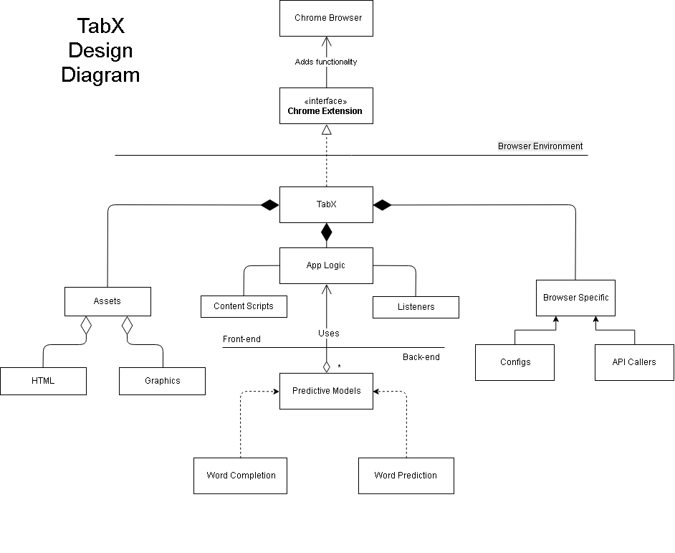
Notes:
Somewhat Detailed Architecture/Specification
For this presentatio
n we want to see more detailed technical documentation in the form of things like architecture diagrams, ER diagrams (or some other database spec), interfaces between major system components, GUI sketches/mockups, user stories, etc. (You don't need to do all of these things)
Your job is to think about what kind of documentation you could hand to an implementation team to explain how the system is supposed to work.)

Slide 29
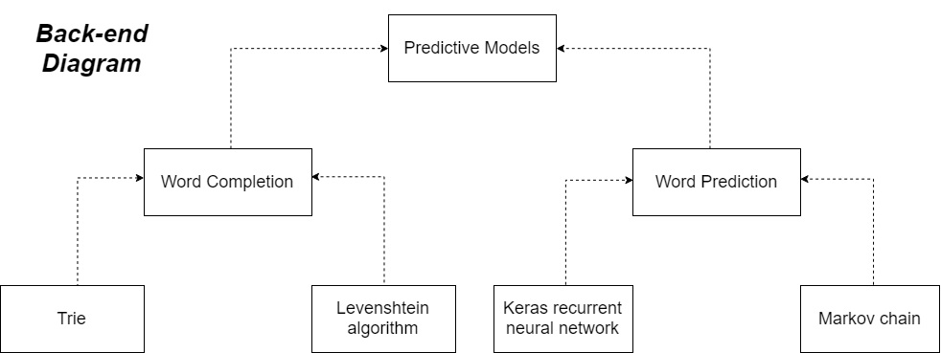

Slide 30
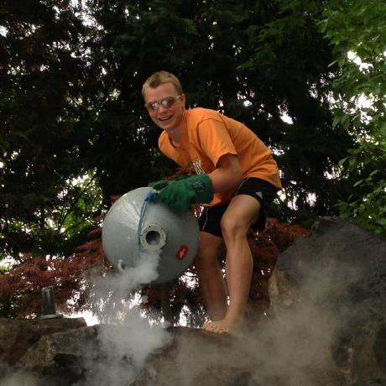
Next Steps
To the infinity and beyond
Notes:
Brussell Sprouts, just talk. We trust you.
To be more concrete, explain the impact of our new challenges, plans, and specifications in how we will make progress. This is not just a summary, but insight into why we included the things we did
into this presentation.

